Slide 1
Project Management Scrum Agile
Alexander Flood

Slide 2

What's The Deal?
THE SITUATION
Users are increasingly seeking feature-rich applications, demanding our team adapt to every changing expectations.
Our traditional Waterfall approach is beginning to fall short of delivering the experience our users expect.
THE SOLUTION
A new approach to project management that integrates stakeholder feedback to drive rapid, iterative development.

Slide 3
Agile/Scrum
The Agile methodology, particularly the Scrum framework, is utilized for its iterative and flexible approach to project management. Stakeholders are elevated to activate participants where their continuous feedback is used to drive development.
This Scrum-Agile methodology has taken the world by storm and can be found in many companies and industries.
According to The Project Managers Guide to Mastering Agile, "Scrum has become rapidly accepted as the most widely used agile methodology in the United States and its usage is rapidly expanding in other areas of the world as well. It provides a good general foundation that can be adapted to fit a very broad range of projects (Cobb, 2015b, p. 33)."
Implementation of our own Scrum-Agile framework to build and organize our teams around will not only align our practices with current trends, but it also ensures our projects will remain modern, competitive, and aligned with our client's expectations.

Slide 4
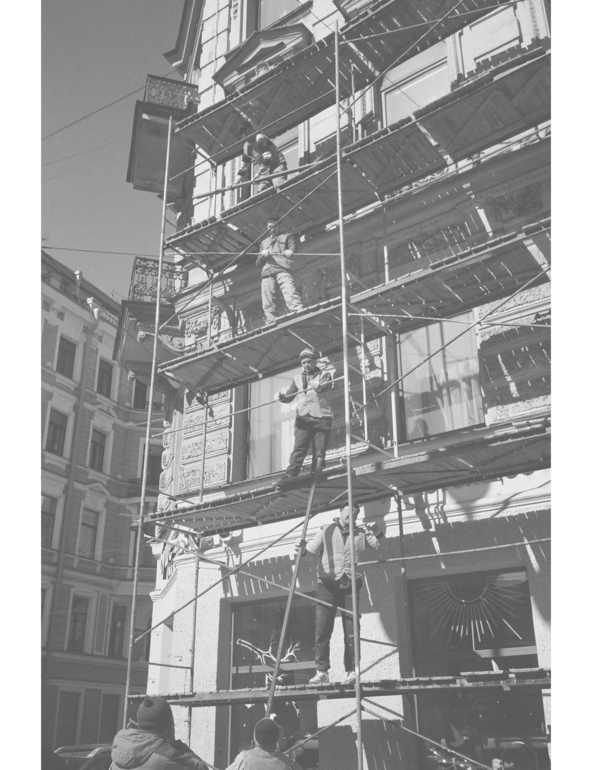

Meet the team
The Scrum team is a collaborative unit. All members are equal and open communication is paramount to success.
While we will see each role holds different responsibilities, each one plays active part in product development.
The SCRUM TEAM
The Team Roles
Product Owner
SCrum master
Developer
Tester
4

Slide 5

Product Owner
The product owner helps bridge the gap between what a client expects and what a team delivers. They translate a client's vision into user stories assigns them to a backlog with a given priority.
According to [], "The Product Owner represents the business sponsor, is a decision maker for the project, provides direction to the team on what will be built, and prioritizes the work to be done."
While the precise responsibilities of a Product Owner will vary from team to team, you can generally find their responsibilities often translating client needs into actionable pieces of work and prioritizing their importance for the team.
In their Scrum Guide, Schwaber and Sutherland (2020, p. 6) give a few common responsibilities a Product Owners often hold:
Ordering the items in the Product Backlog.
Optimizing the value of the work the Development team performs.
Ensuring the Development team understand the items in the Product backlog to the level needed.

Slide 6
SCRUM master
The Scrum Master, despite the way the name sounds, serves as a team facilitator. Since Scrum teams are self-organizing, as opposed to explicitly delegating who does what, they seek to serve the team and resolve issues.
According to The Project Managers Guide to Mastering Agile, G. Cobb writes, "The Scrum Master is what is known in agile as a servant leader. He/she has the responsibility to facilitate the team. He/she is not expected to provide a significant amount of direction to the team as a project manager would..."
Project Managers transitioning to this role may be used to guiding their team in a more traditional fashion, but you will find Scrum Master responsibilities do not mirror that of a traditional project managers.
In their Scrum Guide, Schwaber and Sutherland (2020, p. 6) give a few common responsibilities a Scrum Master may hold:
Leading and coaching the organization in Scrum adoption.
Planning Scrum implementation within the organization.
Helping employees and stakeholders understand and enact Scrum and empirical product development.

Slide 7
Developer
The developer on a team works collaboratively with the Tester in tackling user stories prioritized by the Product Owner and delivering functional features that meet the established requirements.
A developer may use many tools and technologies to accomplish any given task and they should be working with the Tester to make sure all code produced is tested and documented as reasonably as possible.
Developers should be sure to maintain open communication with all members of the team and should be sure to communicate and blockers to the Scrum Master and seek clarity of any ambiguities from the Product Owner.
A common list of responsibilities can be found in the Scrum Guide by Schwaber and Sutherland (2020, p. 5):
Creating a plan for the sprint/sprint backlog.
Adapting their plan each day towards the sprint goal.
Holding each other accountable as professionals.

Slide 8
Tester
The Tester is as crucial as any other member in a Scrum-Agile team. Together with the Developer, the Tester helps deliver fully functional features by developing strong and robust test cases with robust pass/fail criteria.
Each user story tells us in plain English what kind of feature a user wants to see. Making sure this feature acts as the user expects requires thorough testing. One way to ensure thorough testing is adhering to test-driven development.
In the Scrum Guide by Schwaber and Sutherland (2020, p. 76), they explain, "It is typically used in conjunction with unit testing by developers. Rather than writing some code first and then, as a secondary step, writing tests to validate the code, the developer starts by writing a test..."
To drive this form of development, it is crucial that testing is no longer treated as a last step process, but actively practiced throughout the project.

Slide 9
Scrum-agile phases
PLANNING
REQ ANALYSIS
DESIGNING
BUILDING
TESTING
DEPLOY

Slide 10
Planning
Initial project mission and principles are established collaboratively as a team. General requirements are identified, and project scope is determined.
The team will develop and establish working processes to facilitate success of the project.
Req Analysis
Stakeholders express their needs which are then taken by the Product Owner and converted into user stories. The stories are prioritized and added to the backlog.
The Development team and testers can provide input on prioritization of the backlog and ask for clarity where any might be needed.
User stories will give our project a vision to follow and guide feature development each Sprint.

Slide 11
DESIGN
From the user stories, key decisions are made about which technologies and methods are used to complete each user story.
Developers during this phase will brainstorm different design patterns and strategies to complete each feature while another team member might begin to mockup UI.
Building/Coding
Developers start building the software and features based on prioritization the user stories. If test-driven development is employed, the tester and developer will collaboratively build test cases as each feature is developed.
An iterative approach is taken in the Agile method. Based on feedback, each feature is subject to change.

Slide 12
Testing/Review
While testing should be continuously implementing during the build phase, acceptance testing is performed afterwards to ensure each feature is functioning as expected before delivery.
Stakeholders will meet with the stakeholders to validate features and feedback is relayed back to the team for further refinement before delivery.
DEPLoy
Software is delivered to the client. Any supporting documentation or training is also provided. The Product Owner will maintain open communication with the client to relay any feedback or issues that are experienced in production.
This feedback is collected and prepared for the retrospective and next Sprint.

Slide 13
RETROSPECTIVE
Given the iterative nature of the Scrum-Agile process, a retrospective is held in between each Sprint. This serves as a learning experience for the team and a chance to improve on the process.
In The Project Managers Guide to Mastering Agile, Cobb (2020, p. 43) explains, "The sprint retrospective is an opportunity to review and discuss lessons learned at the end of the sprint where the team looks back, reflects on what went well and what didn't go well, and identifies opportunities for process improvement."
This Scrum event gives the team a safe environment to voice their concerns and ideas and refine their Agile process to better serve the stakeholders.

Slide 14




Waterfall
In a traditional Waterfall management approach, you will often some variation of similar phases: requirement analysis, design, building, testing, and delivery. The biggest difference is, the process is not iterative.
The Project Managers Guide to Mastering Agile explains, "…the waterfall model is plan-driven; it attempts to define and document detailed requirements and a plan for the entire project prior to starting the project (Cobb, 2015)." This is because the process is not fluid like Agile. Once a phase is complete, it is often not possible to go back.
A project managed in the waterfall method will spend far more time in the requirement analysis and testing phases, which slows down development without guaranteeing delivery.
For instance, if you deliver the product and the stakeholders explain that that a key feature does not function correctly, it may be too late to fix the issue. In some extreme cases, a project following the Waterfall model may have to start completely over if it is discovered requirements were misunderstood.
In an Agile framework, these issues are more likely to be caught by stakeholder participation. If a feature is not working as expected, it can be remedied the following Sprint.

Slide 15
An Agile future
THE CHOICE
Due to the increasing demand of feature rich applications and evolving trends, I think it is clear a Scrum-Agile model is a clear choice for organizing our teams.
It is clear to me, that the bulk of consumer software is best developed with an Agile methodology, as it allows the team to change and adapt as the needs of clients and users change.
For example, while working on SNHU Travel the stakeholders expressed their desire to change the direction of the app to a wellness-based approach. Our Agile framework allowed us to take this feedback and deliver a working solution in quick time with great satisfaction from the client.
The agility provided by the Agile methodology fosters a collaborative environment and ensures the final product is aligned with the client's expectations.
For these reasons I believe the Agile methodology is the clear choice for our organization compared to a Waterfall model.

Slide 16
references
Cobb, C. G. (2015a). The Project Manager’s Guide to Mastering Agile: Principles and Practices for an Adaptive Approach. John Wiley & Sons.
Schwaber, K., & Sutherland, J. (2020). The Scrum Guide: The Definitive Guide to Scrum: The Rules of the Game [Pdf]. ScrumGuides.org.

Slide 17
THANK YOU
CS-250
Alexander Flood
Professor Judy Mason
15 October 2023

